Slide 1
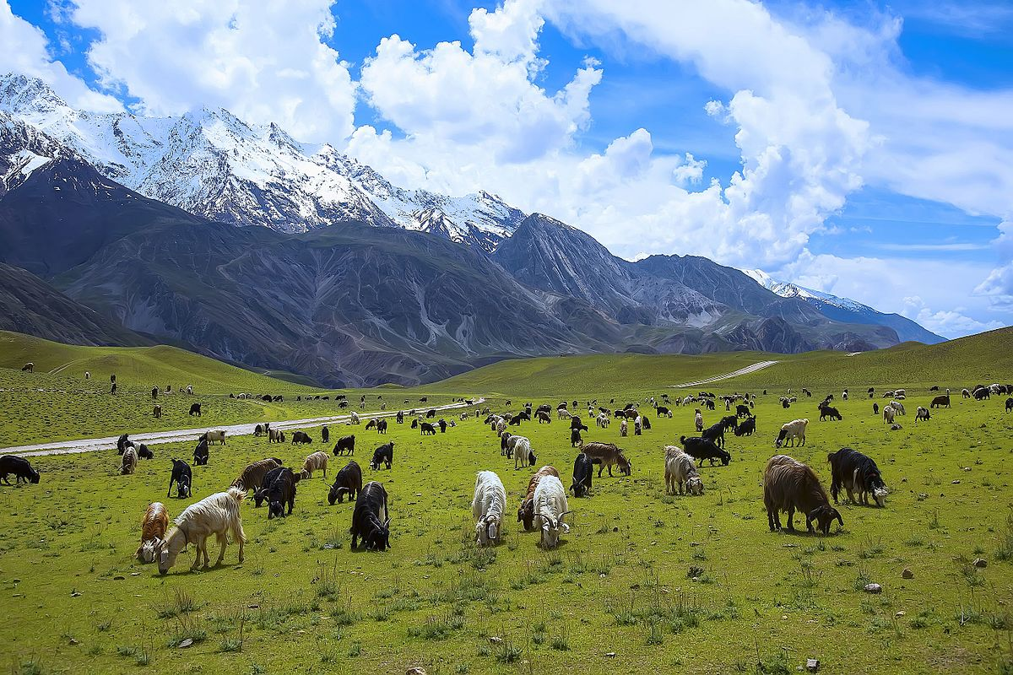
Capstone Option 2: Biodiversity for the National Parks

Slide 2
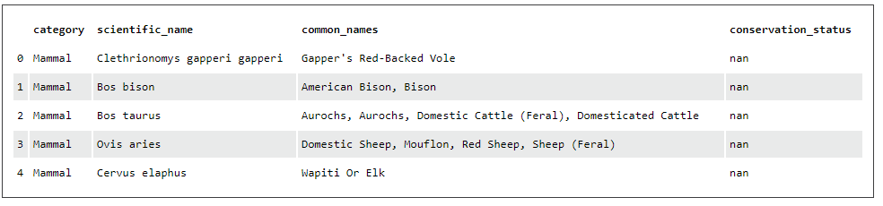
The figure above shows a snapshot of the information contained in the “species” database. The information presented is category, scientific name, common name, and conservation status. The closest thing this data provides to a unique entry value is the scientific name. Thus, it is the scientific name column that must be used when counting unique occurrences.

Slide 3
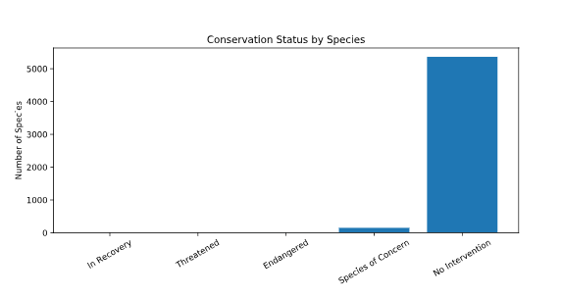
Of 5541 species in the system, 180 fall within the criteria for conservation status. As you can see from the figure above, the majority of species do not require intervention.

Slide 4
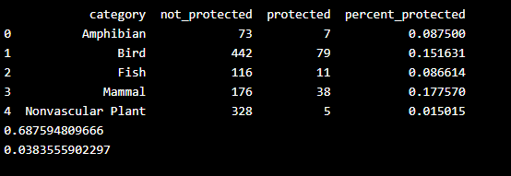
At first we saw a slight difference in the percentages of birds and mammals that fall into a protected category. Our null hypothesis here is that this difference was a result of chance. Since our pval was above 0.05, we do NOT reject the null hypothesis and conclude that the difference is not significant and thus is, indeed, a result of chance.
When comparing the percentages of protected reptiles and mammals in the same chi-squared test, the p-value of ~0.038 is smaller than 0.05, which means it is significant.
Thus, we can say that certain types of species are more likely to be endangered than others.

Slide 5
0.824794298152
0.781450468652
0.781450468652
Fish x Amphibian: 0.824794298152 (not significant, chance)
Reptile x Amphibian: 0.781450468652 (not significant, chance)
Amphibian x Bird: 0.175936132496 (not significant, chance)
Fish x Mammal: 0.0561483484489 (not significant, chance)
In most comparisons, the result is not significant enough to mean that a species is more likely to be endangered. However, we saw in the previous slide that reptiles are more likely than mammals to be endangered. My recommendation for conservationists is to keep an eye on reptiles as they are more likely than mammals to be a species of concern.

Slide 6
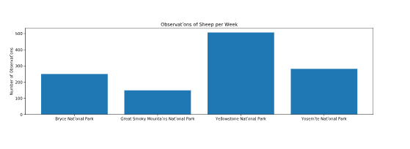
To determine the sample size for the Foot and Mouth Study, I used a sample size calculator using the following inputs:
baseline= 15
minimum_detectable_effect= 33
sample_size_per_variant= 890
Minimum detectable effect was calculated by saying minimum reduction measured divided by baseline= 5/15 = 33%
Since Yellowstone observes 507 sheep per week, and they need at least 890 sample size, 890/507= 1.75 weeks required.

Slide 7
Thank you!

